Slide 1
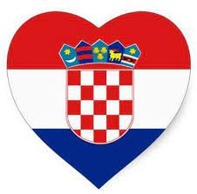
IPPA Croatia, October 2023

Slide 2
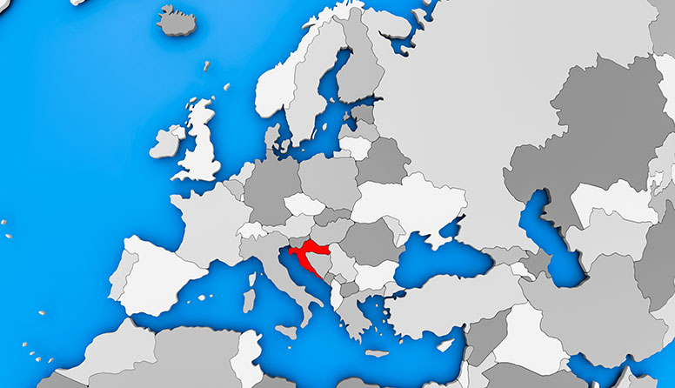
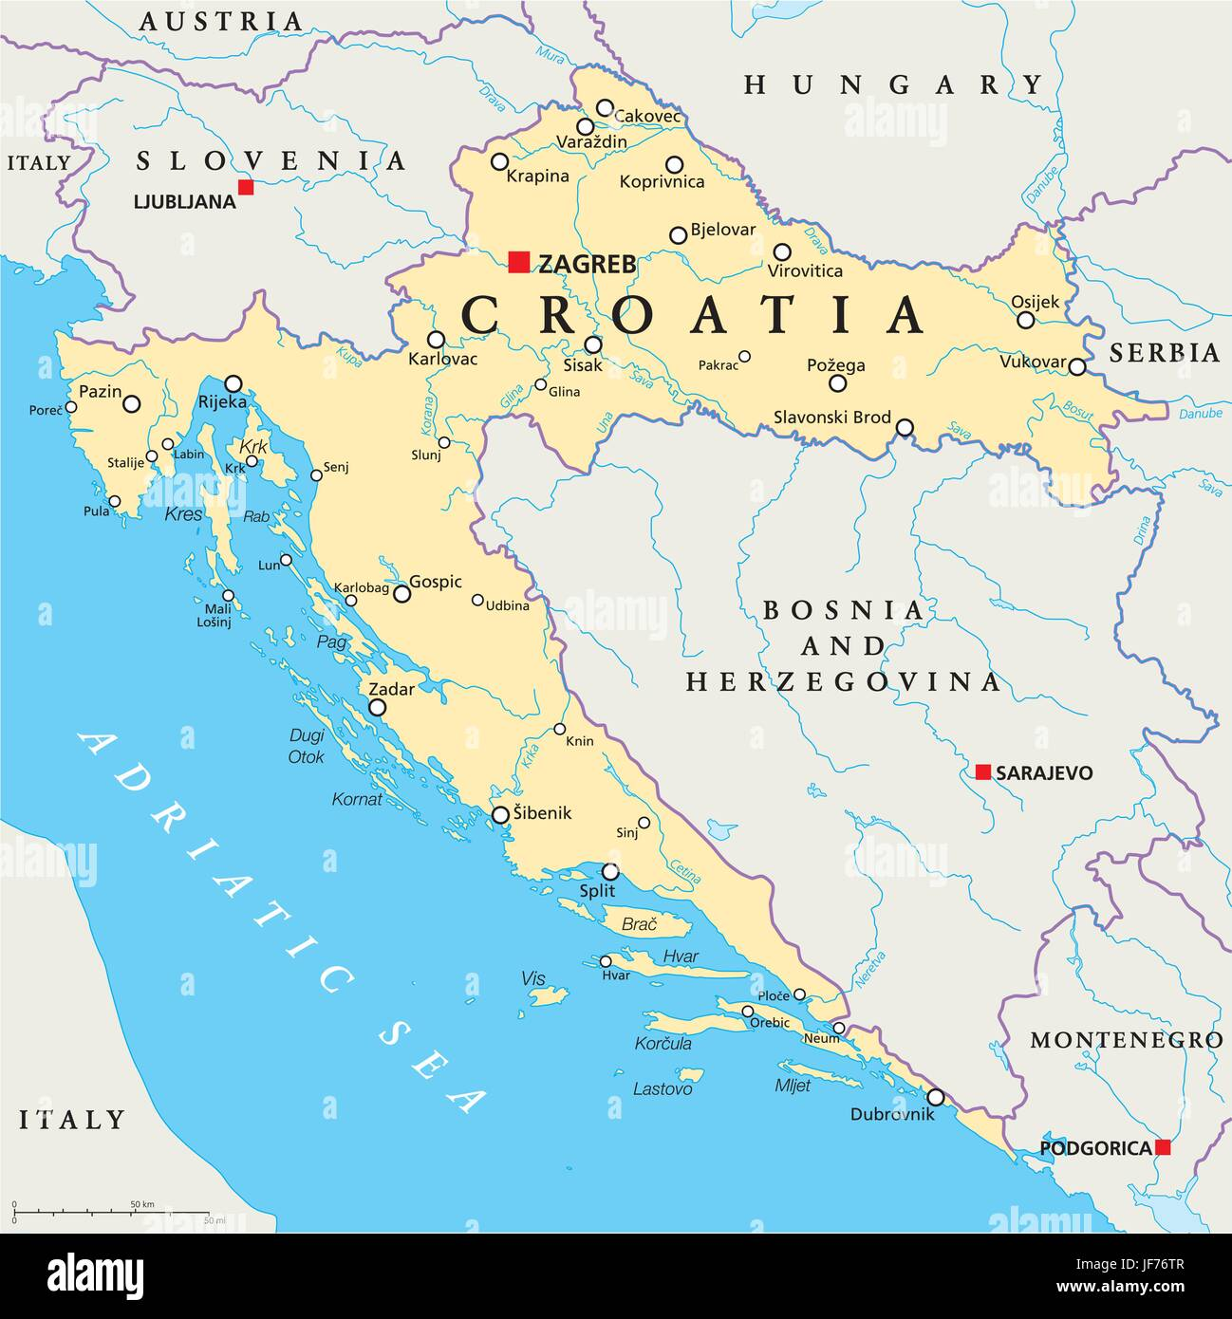

Slide 3
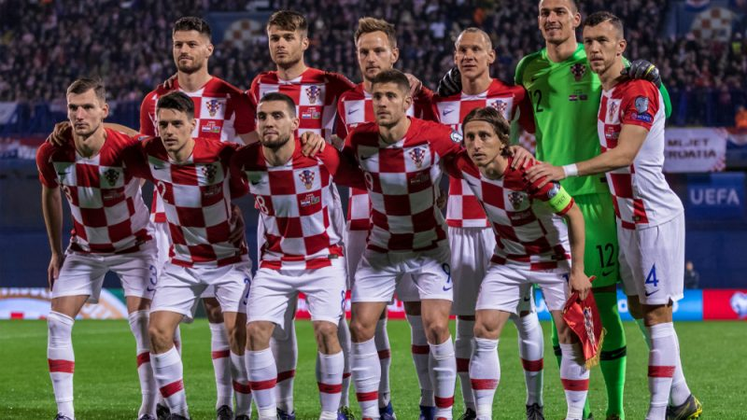
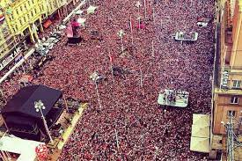

Slide 4
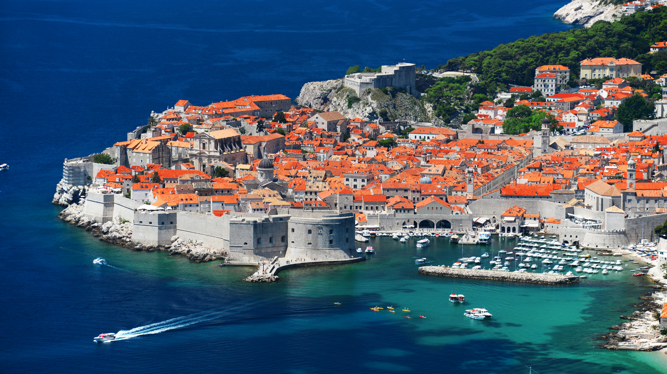
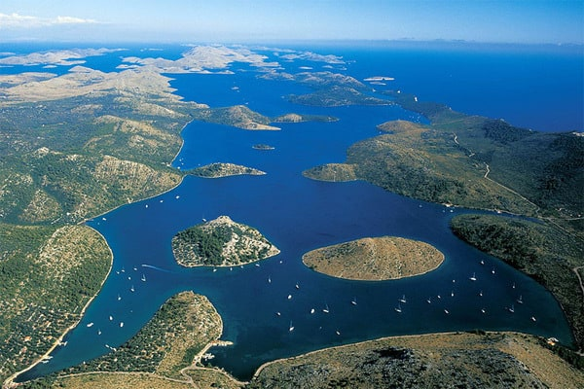
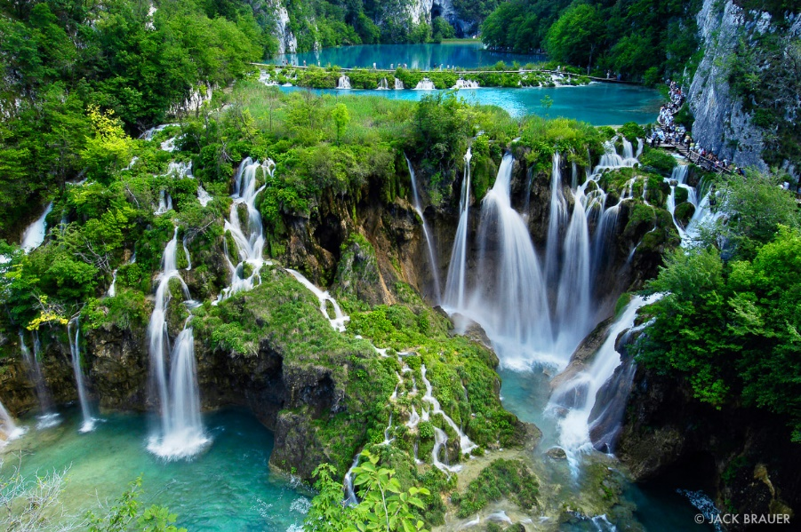

Slide 5
Split, Croatia
2nd largest city in Croatia
founded as the Greek colony of Aspálathos (Aσπάλαθος) in the 3rd or 2nd century BC
Ancient capital of the Roman province of Dalmatia, Salona.
Byzantine city
Republic of Venice
Kingdom of Croatia

Slide 6
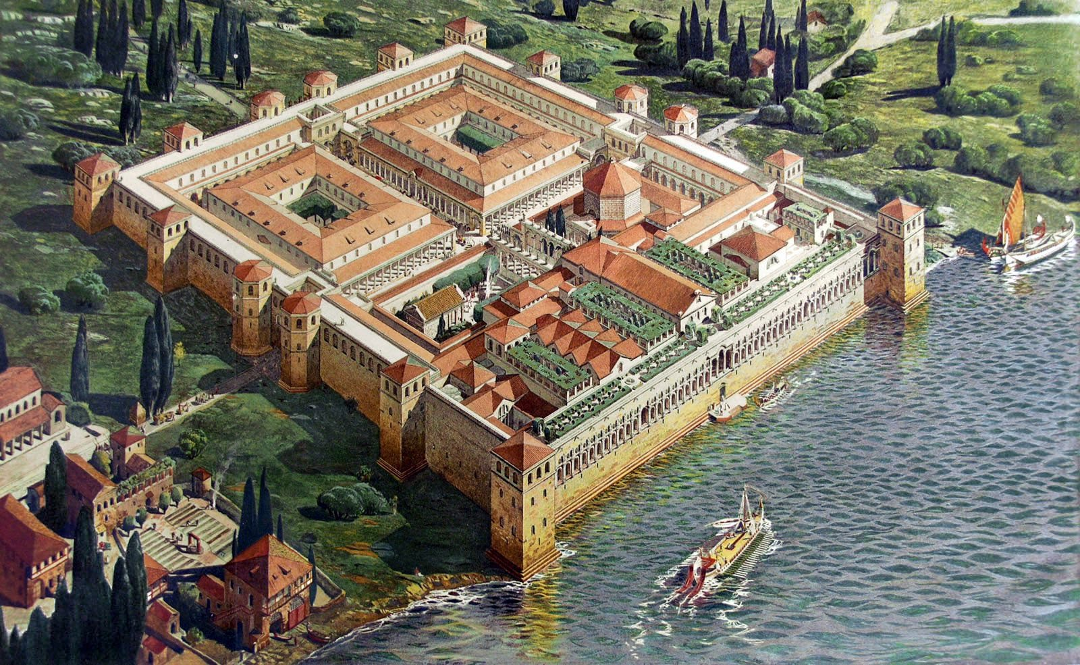

Slide 7
Diocletian's Palace
built for the Roman emperor Diocletian at the turn of the fourth century AD
UNESCO protected monument
Heart of the Old City
„If you could show the cabbage that I planted with my own hands to your emperor, he definitely wouldn't dare suggest that I replace the peace and happiness of this place with the storms of a never-satisfied greed”

Slide 8
Bell Tower of St. Duje Cathedral
The oldest Catholic cathedral in the world
7 th century AD
The best city view from the bell tower!

Slide 9
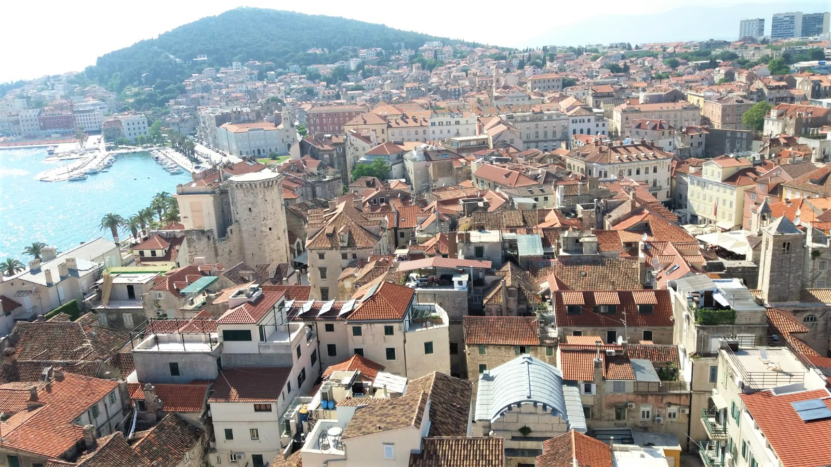

Slide 10
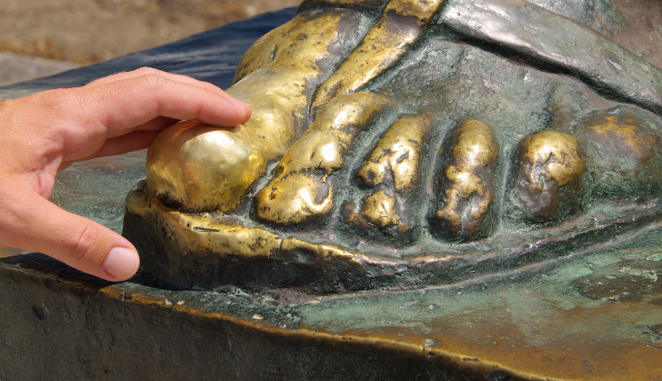
Gregory of Nin
Bishop Gregory introduced the national Croatian language into Catholic services in Croatia after the Great Assembly in AD 926, finally making it possible for everyone to know what was being said.

Slide 11
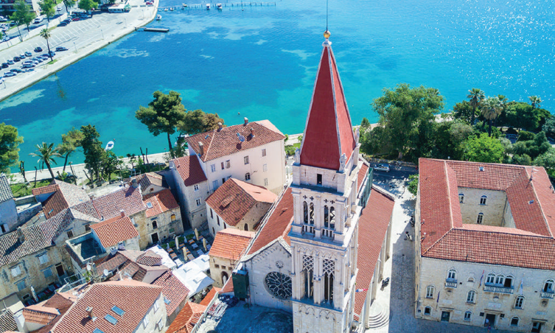
SALONA and TROGIR – The oldest city on the Adriatic coast

Slide 12
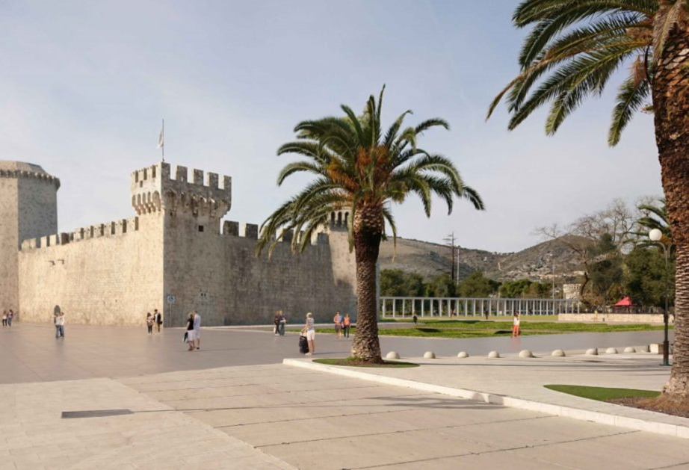
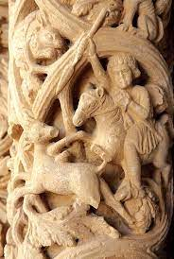
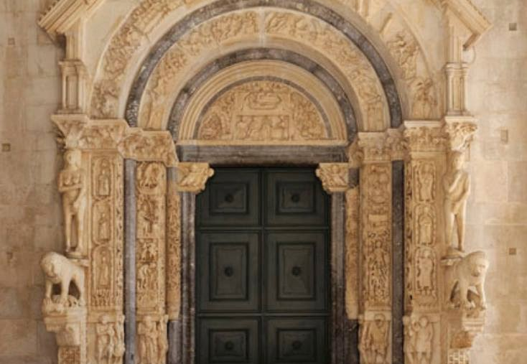
TROGIR
2300 years old city
Historic centre is included in the UNESCO list of World heritage sites

Slide 13
Salona
Ancient city capital of the Roman province of Damatia
3rd century BC

Slide 14
Klis Fortress
The key of Dalmatia and heart of medievel Croatian Kingdom
15 century on the crossroads of 3 empires:
The Ottoman
The Venetian Republic
The Habsburg Monarchy

Slide 15
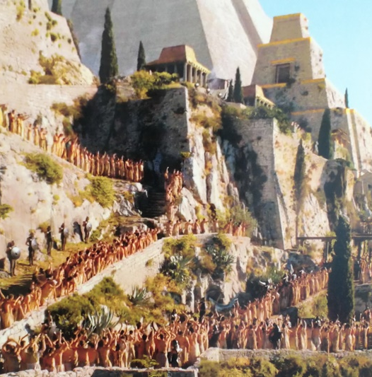
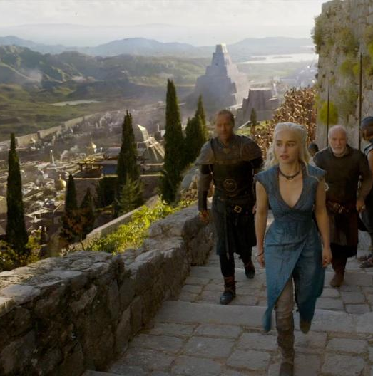

Slide 16
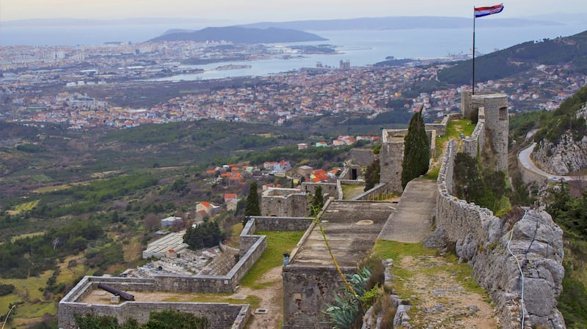

Slide 17
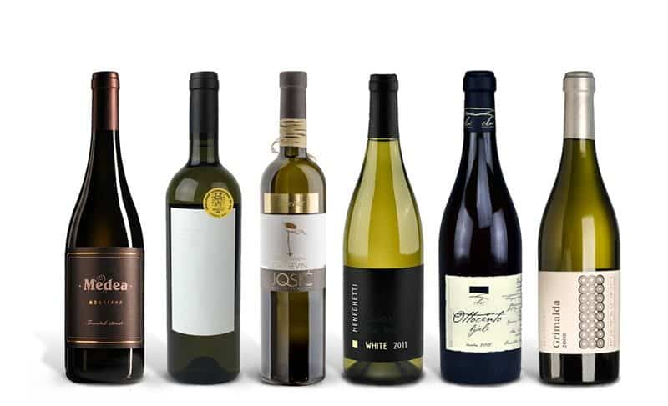
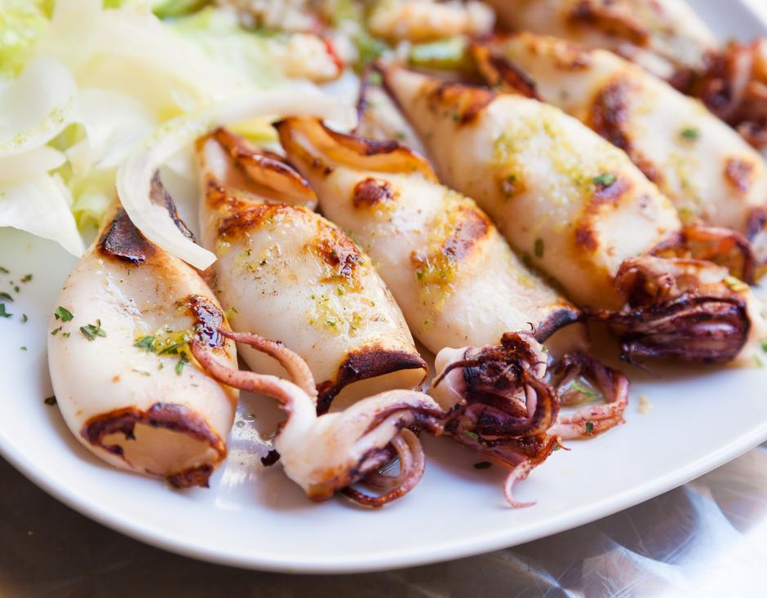

Slide 18
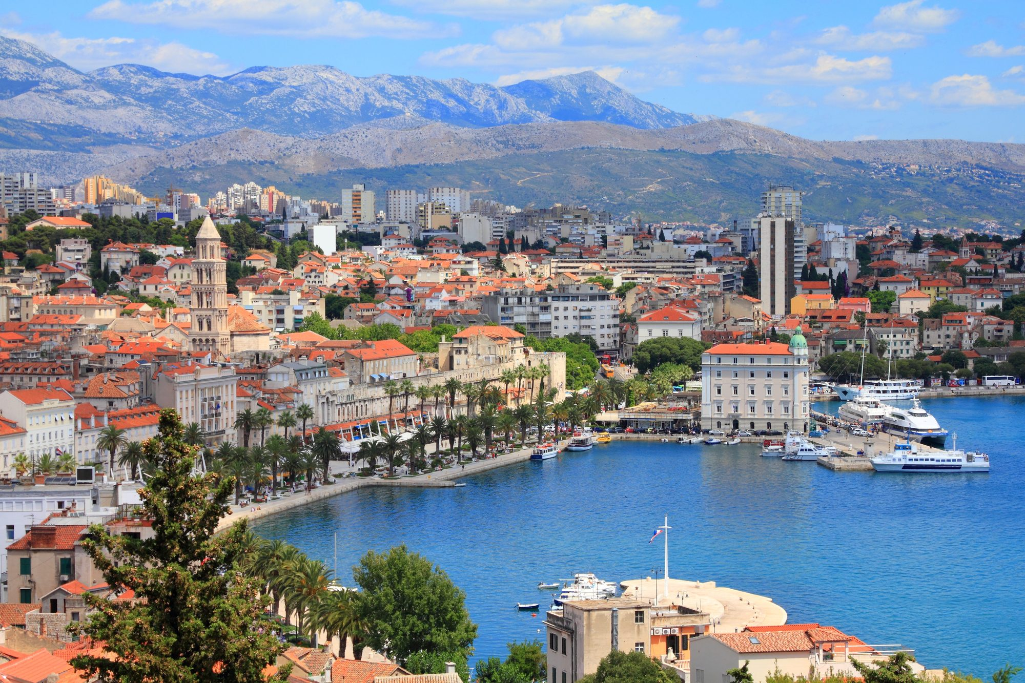
The most common catchphrase in Split is
„POMALO”
Or
Take it easy!
Thank you and hope to see you all in Split

